Slide 1


Slide 2

Edited by the International Mobility Unit

Slide 3


Important information for the audience:
a Q&A session has been planned at the end of the presentation.
Please take note of all the questions you have for us!
Notes:
Ciao a tutti - welcome to our presentation on international recruiting and sustainability.

Slide 4
WHAT’S ON THE
AGENDA TODAY…
Erasmus+ Study
Erasmus+ Traineeship
Overseas Exchange Programme + ISEP Exchange
Double Degrees
Erasmus+ Blended Intensive Programmes
EC2U Alliance
Language certificates and requirements
Italian Erasmus
How to get in touch with us
Q&A Session

Slide 6
MANY POSSIBILITIES TO GO ABROAD WITH UNIPV
Exchange Programmes
Tuition fees waived
Study in a foreign Institution: 609 partner Institutions with 2-4 spots – 90% of applicants are successful
Scholarships opportunities
Traineeship Programme
You choose the company – 90% of applicants are successful
Scholarships opportunities
Available for recent graduates
Double and Joint Degrees
Tuition fees waived
Double or multiple degree titles: 26 partner Institutions with 2-6 spots
Scholarships opportunities
Short Programmes
Tuition fees waived
Virtual or blended classes
STUDY ABROAD
Traineeship Programme
Double and Joint Degrees
Short Programmes
Exchange Programmes

Slide 7
ERASMUS+ STUDY
WHAT
Mobility for study
for one semester or full academic year
      Attend courses and take exams, carry out research activity for thesis, and combine a traineeship
  Full recognition of the completed activities at the end of the period
WHERE
  EU Countries
  +
  Switzerland, United Kingdom
  +
  China, Morocco
  Verify the available destinations for your department/Erasmus Area
WHO
  All students enrolled at UNIPV

Slide 8
ERASMUS+ STUDY
HOW
2 calls for applications per year
  Selections at Department/Area level based on: merit + motivation + language knowledge
  Final assignment of destination
GRANT
  EU (to be confirmed by the National Erasmus Agency):
  between 225,00 and 700,00€/month (depending on the host country)
  +
  250,00€/month for participants with fewer opportunities
  +
  travel grant
  UNIPV:
  Top-up according to the financial situation
WHEN
  I call: end of January + selections in April
  Departures: September/October
  (I semester or full year)
  January/February (II semester)
  II call: June + selections in September
  Departures: January/February
  (only II semester)

Slide 9
ERASMUS+ TRAINEESHIP
WHAT
Mobility for traineeship
from 2 to 12 months
      Carry out an internship period, or research activity for thesis
  Full recognition of the completed activities at the end of the period
  (for students)
WHERE
  Worldwide (limited exceptions)
  Enterprises, public/private Institutions, NGOs, Universities, Research centres, etc.
  Tips to find a place: direct contacts (on your own or through a professor), web, Erasmus website, Jobteaser
WHO
  All students enrolled at UNIPV
  Departures allowed also for recent graduates

Slide 10
ERASMUS+ TRAINEESHIP
HOW
2 calls for applications per year (online)
  Selections at Department/Area level based on: merit + motivation + acceptance letter issued by the host Institution
  Final assignment of destination
GRANT
  EU (to be confirmed by the National Erasmus Agency):
  between 375,00 and 700,00€/month (depending on the host country)
  +
  250,00€/month for participants with fewer opportunities
  +
  travel grant
  UNIPV:
  Top-up according to the financial situation
WHEN
  I call: April + selections in June
  Departures: from July/August
  II call: October/November + selections in December/January
  Departures: from February

Slide 11
OVERSEAS EXCHANGE PROGRAMME
WHAT
Mobility for study for one semester
      Attend courses and take exams, carry out research activity for thesis (not for all destinations)
  Full recognition of the completed activities at the end of the period
WHERE
  Extra-EU Universities:
  Australia, Canada, Japan, Argentina, Brazil and others (complete list available in the call for applications)
  +
  ISEP Exchange
  Verify the available destinations for your course of study
WHO
  Students enrolled in bachelor, master, or one-single-cycle degrees

Slide 12
OVERSEAS EXCHANGE PROGRAMME
HOW
Annual call for applications per year (online)
  Selections at Department/Area level with a single university-wide ranking based on: merit + motivation + language knowledge
  Final assignment of destination
GRANT
  400,00 or 700,00€/month (depending on the receiving country)
  UNIPV: Top-up according to the financial situation
WHEN
  Call for applications: end of January + selections in March/April
  Departures: September/October (I semester)
  January/February (II semester)

Slide 13
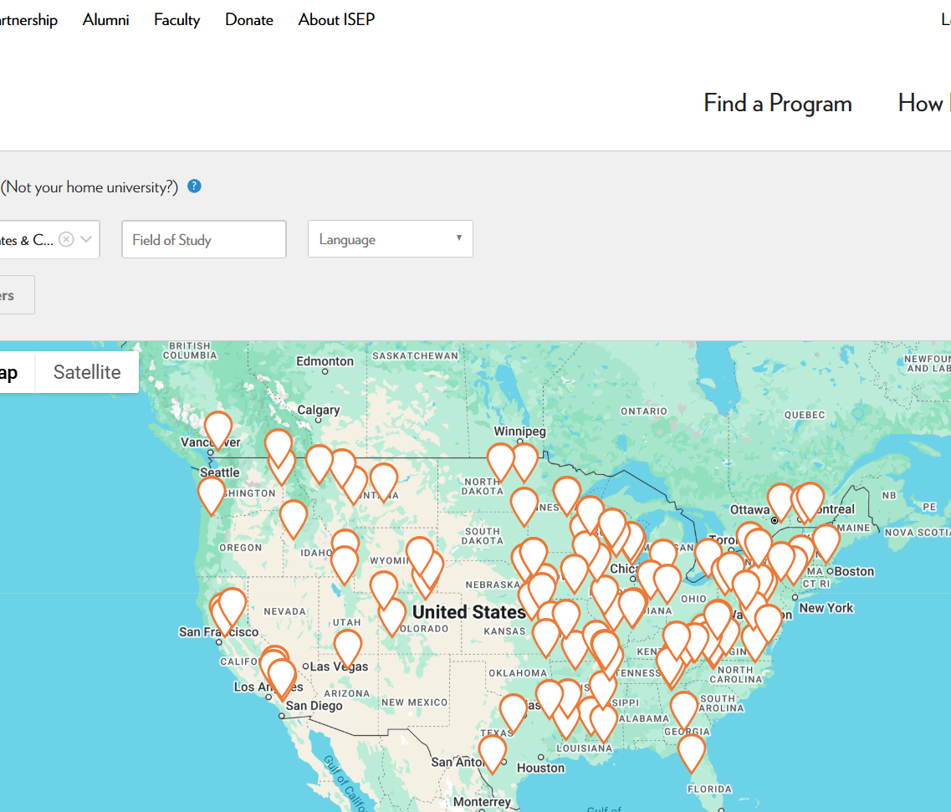

ISEP EXCHANGE
ISEP
A global exchange network offering opportunities for students to study abroad at over 300 Universities in 50+ countries
U.S./International and Global Exchanges
Mission
To make studying abroad accessible to all students, regardless of their financial and academic background
Focus areas
Academic growth, cultural immersion, and personal development
Services
Unique and comprehensive model: tuition, housing and meals included

Slide 14
ISEP EXCHANGE
Students pay tuition and fees to UNIPV
and study at a partner University abroad
SERVICES AND SCHOLARSHIPS
Housing, and meals included
Diverse destinations and academic options
ELIGIBILITY REQUIREMENTS
Be enrolled at a participating ISEP Institution
Meet specific academic and language prerequisites
TUITIONS
ISEP EXCHANGE
How does
ISEP work?

Slide 15

ISEP EXCHANGE
Application process
Research programmes
Identify a list of 10 HEIs, apply through UNIPV Overseas Exchange Programme and participate in the interview
UNIPV nominates students to ISEP based on available spots and course compatibility
List of participating Universities by placement probability
Accept your placement
Placement confirmation
Pay the program fee (100$) + 450$ acceptance fees
ISEP makes the final placement

Slide 16





HOW DO I APPLY?
Erasmus+ Study
Erasmus+ Traineeship
Overseas Exchange Programme
Read the call for applications
Verify that you meet the candidacy requirements
Fill in the online application
Take the language tests
(if required)
Take the selection interviews
(if any)

Slide 17
DOUBLE DEGREES
WHAT
Study path including one year at the partner University = Double Degree (Italian and foreign)
      Attend courses and take exams, carry out research activity for thesis, and combine a traineeship
WHERE
  Verify the available destinations for your department/course of study
WHO
  Students enrolled in master or one-single-cycle degrees

Slide 18
DOUBLE DEGREES
HOW
Annual call for applications per year
  Selections at Department level based on: merit + motivation + language knowledge
  Final assignment of destination
GRANT
  As per Erasmus+ for Study
  or
  UNIPV funds: from 250,00 to 550,00€/month (depending on the financial situation)
WHEN
  Departures: September/October or January/February (only for the DD in Argentina for Law and Political Sciences)

Slide 19

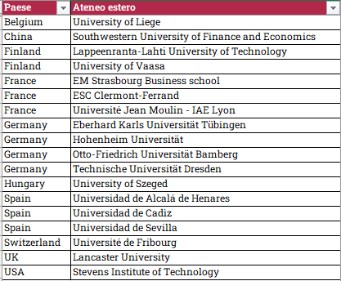
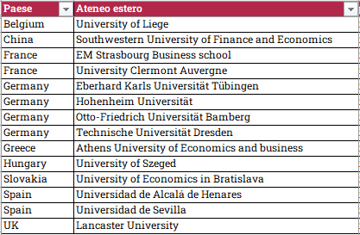

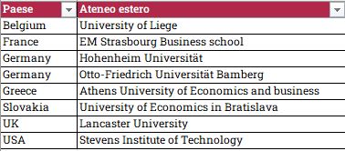
DOUBLE DEGREES
MEGI
MIBE
MEDI
MELI
Finance

Slide 20




DOUBLE DEGREES
Scienze Fisiche
Lingue e letterature per la comunicazione interculturale
Giurisprudenza
Dept. of Political and Social Sciences
Ingegneria Edile-Architettura

Slide 21
HOW DO I APPLY?
Double Degrees
Read the call for applications
Verify that you meet the candidacy requirements
Fill in the online application
Take the language tests
(if required)
Take the selection interviews
(if any)

Slide 22
ERASMUS+ BLENDED INTENSIVE PROGRAMMES
WHAT
Mobility for study
from 5 to 30 days
      Combined virtual and physical lessons to attend courses and take exams, or carry out research activity for thesis
  Full recognition of the completed activities at the end of the period (min. 3 ECTS)
WHERE
  EU Countries
  Verify the available destinations for your course of study
WHO
  Students enrolled in: bachelor/master/one-single-cycle degrees, Ph.D. courses

Slide 23
ERASMUS+ BLENDED INTENSIVE PROGRAMMES
HOW
Different calls for applications during the year
  Selections made by the professor in charge of the BIP based on: merit + motivation + language knowledge
  Final confirmation
GRANT
  79€/day (until the 14° day of activity) and 56€/day (from the 15° to the 30° day of activity)
  +
  2 travel days
WHEN
  Throughout the whole year (depending on the BIP)

Slide 24
HOW DO I APPLY?
Erasmus+ Blended Intensive Programmes
Read the call for applications
Verify that you meet the candidacy requirements
Fill in the online application
Take the selection interviews
(if any)

Slide 25








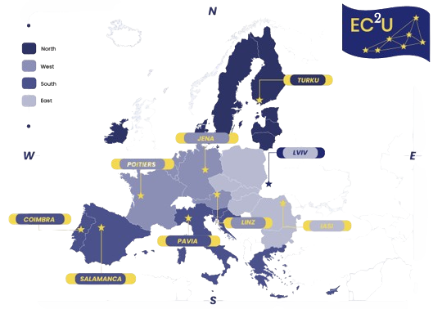
EUROPEAN ALLIANCE
EUROPEAN CAMPUS OF CITY UNIVERSITIES
*NEW ASSOCIATED PARTNER
Ivan Franko University of Lviv

Slide 26


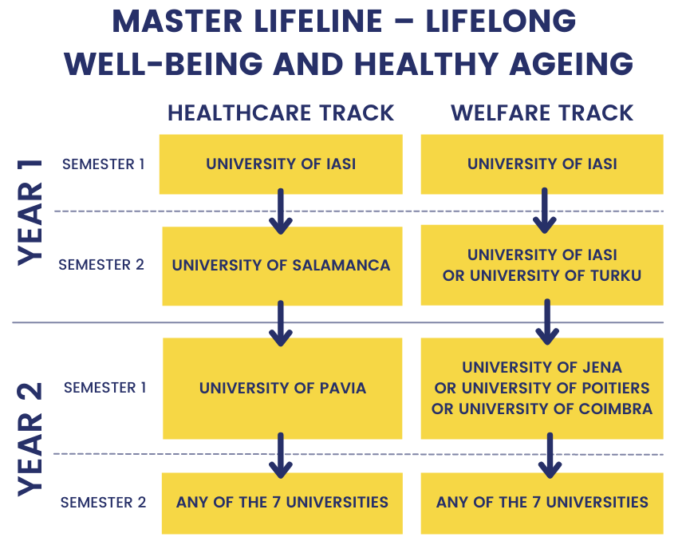
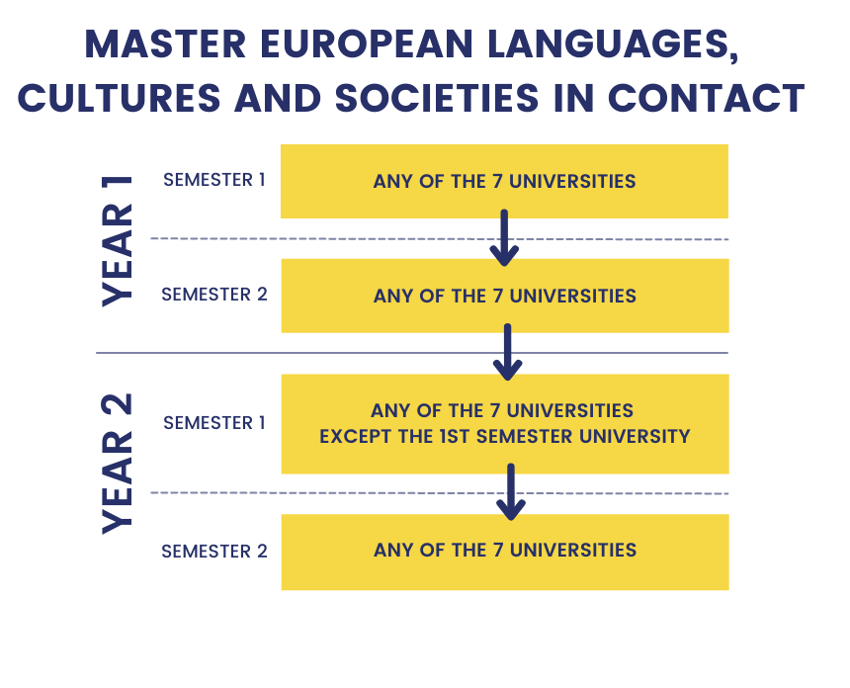
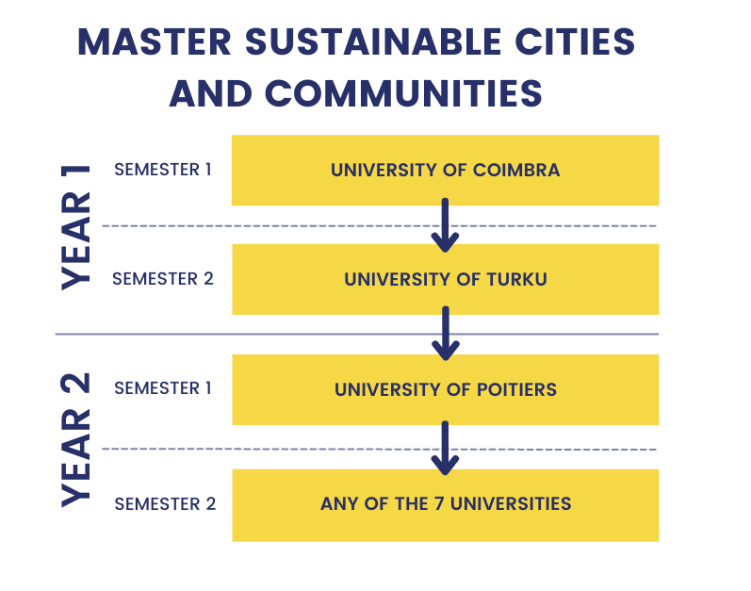
EC2U JOINT MASTER DEGREES
Mobilities are funded by Erasmus+ for study

Slide 27





EC2U NEW INNOVATIVE MOBILITY OPPORTUNITIES
Open badges
Virtual hubs and open lectures
Entrepreneurial weeks
EITEN conference
Summer and winter schools
Ph.D. networks and conferences
Annual Forum
Student events
Ambassador program
Science contest
Think Thank

Slide 28
CALLS FOR APPLICATIONS TIMELINE
Dec
Jan
Feb
Mar
Apr
May
Jun
Jul
Aug
Sep
Oct
Nov
Erasmus for Study
Double Degrees
Overseas Exchange Programme and ISEP
Erasmus for Study
Erasmus Traineeship
Erasmus Traineeship
EC2U short mobilities and Erasmus+ Blended Intensive programmes
are open through the whole academic year

Slide 29

LANGUAGE CERTIFICATES AND REQUIREMENTS
FOR ALL PROGRAMS ADEQUATE LINGUISTIC KNOWLEDGE IS REQUESTED

Slide 30
LANGUAGE CERTIFICATES AND REQUIREMENTS
PROGRAM | TO BE DEMONSTRATED | TYPE OF CERTIFICATE | WHEN TO BE DEMONSTRATED
Erasmus+ Study | yes | International Certification or Certificate provided by CLA | By the closing date of application
Erasmus+ Traineeship | yes | Depending on the host Institution
Erasmus+ Blended Intensive Programmes | yes | Depending on the host Institution/the BIP
Overseas Exchange Programme (included ISEP) | yes | International Certification or Certificate provided by CLA | By the closing date of application or during the selection interview
Double Degrees | yes | International Certification or Certificate provided by CLA | Before departure or by the closing date of application – check application call
EC2U Joint Master Degrees | yes | International Certification | By the closing date of application

Slide 31
UNIPV LANGUAGE CENTRE
Internal language tests
Available for English, French, German, Spanish and Portuguese
When: March 2025 and July 2025
Certified levels from A2 to C1
Online through KIRO Testing
Preparatory activities available in KIRO
Bilingual certificate will be sent to students one week after the test
UNIPV
LANGUAGE CENTRE
cla.unipv.it
International certifications
English: IELTS Academy (next available session: 13th February 2025)
French: DELF-DALF
German: TestDaf
UNIPV students have priority in the enrollement and discounted fares

Slide 32
WHAT IF I CANNOT GO ABROAD?
Participate in UNIPV international activities
Tutor project
Italian Erasmus
ESN activities

Slide 33
ITALIAN ERASMUS
WHAT
National mobility program aimed at promoting interdisciplinary and flexible study paths, fostering integration among Italian Universities – min. 3 and max. 6 months
      Attend courses and take exams, carry out research activity for thesis
  Full recognition of the completed activities at the end of the period
WHERE
  University of Naples ‘’Federico II’’
  University of Padua
  University of Pisa
  University of Bologna
  University of Catania
WHO
  Students enrolled in bachelor or master degrees
GRANT
  600,00€/month for students with maximum 36,000 ISEE

Slide 34
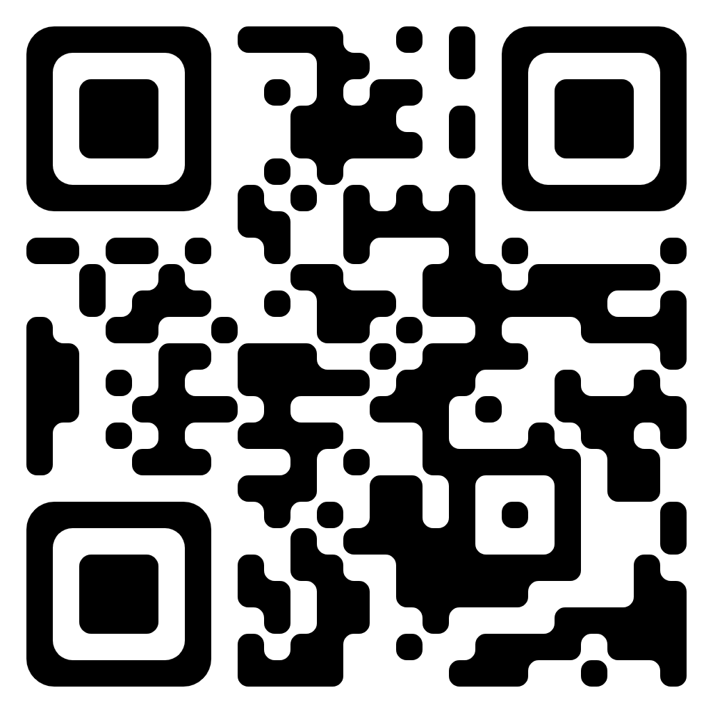
HOW TO GET IN TOUCH WITH
THE INTERNATIONAL MOBILITY UNIT?
One-to-one meeting in a virtual room
One-to-one meeting in presence
By appointment only:
On Wednesday from 13.30 to 15.00
On Friday from 10.00 to 11.30
By appointment only:
On Tuesday from 10.30 to 13.00
BOOK YOUR FAVOURITE TIME SLOT!
https://internazionale.unipv.eu/en/
Click on «About us» and «Contact»
Choose «In presence» or «Virtual»
Notes:
15 mins time slot to answer all the questions related to the mobility or more general questions
The link to book is available

Slide 35

HOW TO GET IN TOUCH WITH
THE INTERNATIONAL MOBILITY UNIT?
Telegram Group - Live Chat service
Every Monday and Thursday from 10.30 to 11.30
One-to-all approach
Chat history available for new members
Chat open only during those hours
JOIN THE GROUP NOW!
t.me/unipvmobilityout

Slide 36
HOW TO GET IN TOUCH WITH
THE INTERNATIONAL MOBILITY UNIT?
E-mail Contact HUB
Erasmus+ for Study, Erasmus+ Traineeship, Overseas Exchange Programme, Double Degrees, EC2U Alliance - outgoing.mobility@unipv.it
Erasmus+ Blended Intensive Programme - erasmusbip@unipv.it

Slide 37
Dai voce alle tue idee e aiutaci a migliorare l’esperienza Erasmus+!
Partecipa al progetto Diversity and Inclusion in Erasmus+ Implementation (DIEM), coordinato da Erasmus Student Network (ESN) International, UNIPV e altre Università e Associazioni Europee.
Rendiamo la mobilità internazionale accessibile a tutti, specialmente a chi affronta più ostacoli.
Invia una mail erasmus@unipv.it entro lunedì 9 dicembre
Quando: Venerdì 13 dicembre alle 9.45
Dove: Ritrovo presso il Cortile delle Statue, Palazzo Centrale dell’Università (Corso Strada Nuova 65)
Durata: circa 2 ore
Cosa vi aspetta:
Un confronto coinvolgente e informale dove esploreremo insieme le ragioni che possono rendere difficile o poco attraente la scelta di un’esperienza di mobilità all’estero
Un coffee break offerto durante l’incontro
Gadget esclusivi dell’Università di Pavia come ringraziamento per il vostro prezioso contributo

